Slide 1
Exploratory vs. Explanatory
And Dashboard Design
Created By: Jeffery A. Shaffer Vice President, Unifund Adjunct Faculty, University of Cincinnati (513) 615-0001 | JeffreyShaffer@gmail.com @HighVizAbility
Notes:
Title Slide

Slide 2
Goals
By completing the course modules, students will:
Learn Exploratory vs. Explanatory visualizations
Discuss the definition of a dashboard
Learn fundamentals of dashboard design
Learn what makes data visualization actionable

Slide 3
Exploratory vs. Explanatory and Dashboard Design

Slide 4
Process of Discovery
No matter how well-designed your graphic is, users will want to know “why” or to look at things in a different way.
Exploratory discovery
Give users tools to find the answer
Allows analysts and power users to find new patterns and relationships
Directed discovery
Show the answer to a pre-known question
Options to change basic parameters
Suitable for general consumption by a wide variety of users

Slide 5
What is a dashboard?

Slide 6
one definition of a dashboard
A dashboard is a visual display of the most important information needed to achieve one or more objectives; consolidated and arranged on a single screen so the information can be monitored at a glance.
- Stephen Few (2004)
From “Dashboard Confusion” in Intelligent Enterprise magazine, March 20, 2004
Notes:
Stephen Few’s definition of a dashboard is very specific. He does not believe that something interactive or exploratory is by definition a dashboard.

Slide 7
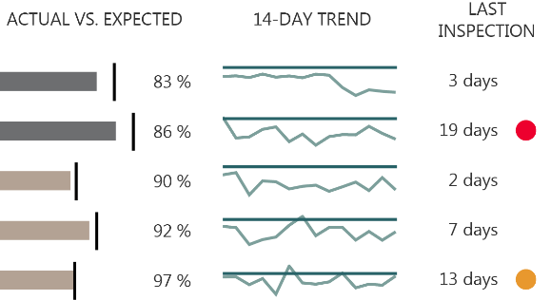
Dashboards as Directed Discovery
Another way to think about it:
An information display designed for people
to help maintain situational awareness.
Source: The Big Book of Dashboards (BigBookofDashboards.com)

Slide 8
vs. a “faceted analytical display”
A “faceted analytical display” is a set of interactive
charts (primarily graphs and tables) that simultaneously reside on a single screen, each of which presents a somewhat different view of a common dataset, and is used to analyze that information.
- Stephen Few (2007)
From “Dashboard Confusion Revisited” from PerceptualEdge.com, March 2007
Notes:
Stephen Few’s definition for an interactive dashboard or and exploratory data visualization is a “faceted analytical display”. This still “resides on a single screen”, but provides different views of the data based on the user’s interaction.

Slide 9
one definition of a dashboard
A dashboard is a visual display of the most important information needed to achieve one or more objectives; consolidated and arranged on a single screen so the information can be monitored at a glance.
- Stephen Few (2004)
From “Dashboard Confusion” in Intelligent Enterprise magazine, March 20, 2004
Notes:
[class discussions]
Do you agree with Mr. Few? Does a dashboard have to be a single screen? And does it have to be designed for ‘at-a-glance’ monitoring?

Slide 10
another definition of a dashboard
A dashboard is a visual display of data used to monitor conditions and/or facilitate understanding.
- The Big Book of Dashboards (2017)
Notes:
Here is another definition of dashboard from The Big Book of Dashboard. How about this one?
This is a very broad definition. How does it differ from the definition of “data visualization”?
[class discussion]

Slide 11
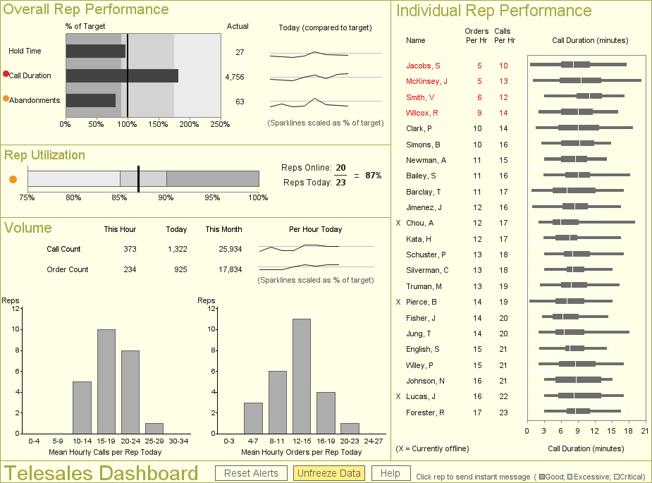
Dashboards – Supporting Attributes
Information is presented using small, concise, direct, & clear display of media
Clearly stated messages
Each point should be limited to the space needed
Customized
tailored to the needs of a specific group or individual
Consistent layout
Data changes over time
Interface is consistent (until it’s time for the next revision)
Few, Stephen (2013), Information Dashboard Design, p. 28

Slide 12
Dashboard and KPI Rollups Different Views for Levels of the Organization
CEO - Strategic
Manager - Tactical
Team - Operational
Prospects
Customer
Marketing
Sales
Billing
Potential customers and activities
Key customer contact data
Outbound and marketing response
Orders and fulfillment
Accounts receivable and collections
Notes:
Who’s the audience? And what’s the message? When designing dashboards it’s important to understand the user. The executive team will need high-level summary information about the global business, the Director or Manager will be more tactical, focusing on a department of business unit. Others on the team will need operational information. They may even need to drill-down into record-level data.
The key performance indicators will be different for all of these groups. It will be important to know what they are so that they can be visualized in a meaningful way.

Slide 13
KPI and Scorecard Rollups Example Scope and KPI Categories
CEO - Strategic
Manager - Tactical
Team - Operational
Many KPI categories:
Industry Benchmarks
Cash Flow
Risk and Security
Customer Satisfaction
Asset Management
HR
Information Quality
Organizational Topline and Risk
Division Performance
Team KPIs
Sales Activities
Loyalty & Retention
Campaign Success
Revenue and Profit
Bad Debt
Prospects
Customer
Marketing
Sales
Billing
Potential customers and activities
Key customer contact data
Outbound and marketing response
Orders and fulfillment
Accounts receivable and collections
Notes:
At the top we see KPIs that relate to the organization’s topline or maybe enterprise risk. In the middle, Division performance and at the bottom the team KPIs. Each team may have a different objective, for example Sales Activity vs. Loyalty and Retention or Revenue and Profit. It is important to understand the audience, at whatever level of the organization, so that the information can be tailored to that audience.

Slide 14
Compare and Contrast

Slide 15
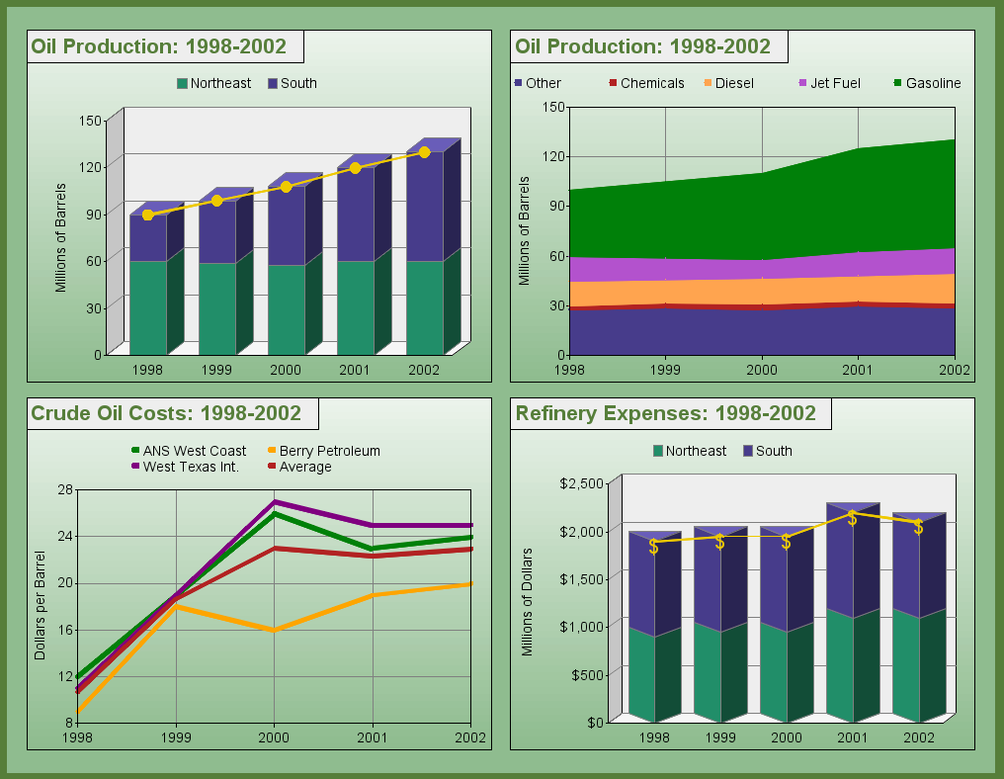
Source: “blinged dashboard” from http://robslink.com/SAS/democd36/oil_blinged.htm
Notes:
We learned in module 1 how the mind perceives information. Gradient colors and background colors can affect the way we perceive color. 3D effects can hide or even distort the data. Simple changes can have a dramatic impact.

Slide 16
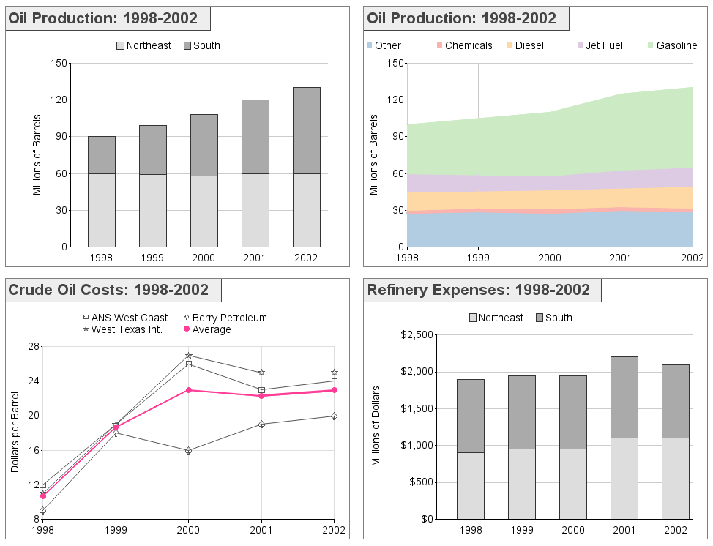
Source: “unblinged dashboard” from http://robslink.com/SAS/democd36/oil_unblinged.htm
Notes:
Compare that dashboard to this one, which removes the gradient colors and 3D effects and changed a few colors. The other graphing elements are basically the same.
[class discussion]
This example was created in 2002. What additional changes could we make today to improve this even more?

Slide 17
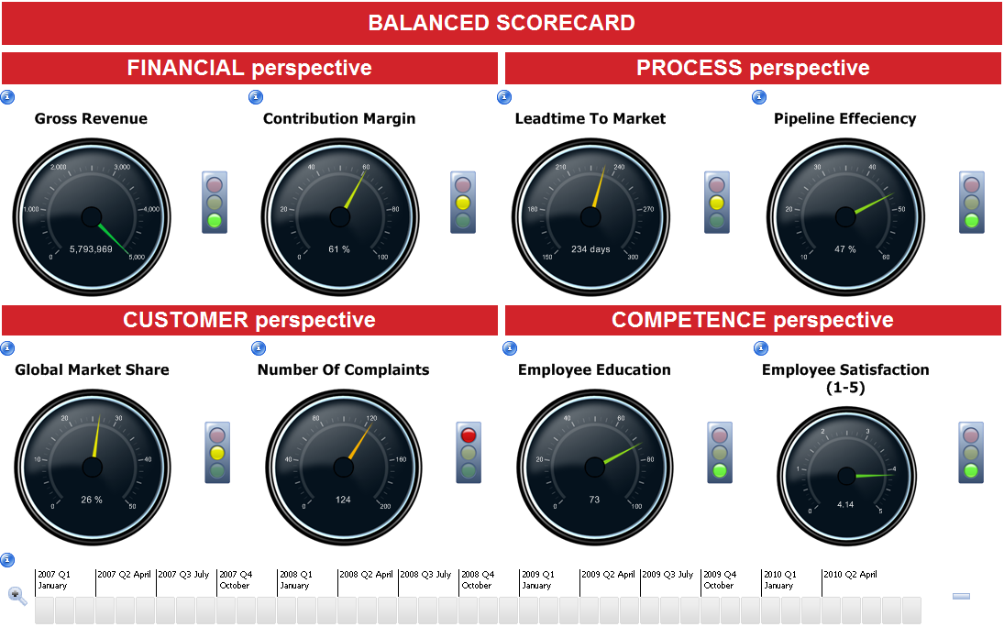
Dashboard – Low Effectiveness
Source: Targit BI Balanced Scorecard from https://www.youtube.com/watch?v=4vuoQgYPdAw
Notes:
Some software tools offer tools like Gauges, which take up lots of space and limit the view of the data. For example, if the gauge goes from 0 to 100% then it’s bounded. What happens if the performance exceeds 100%? It also makes comparing the data across gauges very difficult.

Slide 18
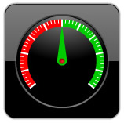
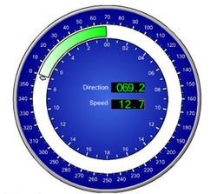
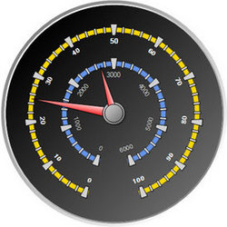
Avoid Useless Bling
Some of the widgets and displays provided by tool vendors are glitzy but unhelpful – like these:
Require a disproportionate amount of room for the information presented
Hard to read and understand
Little actionable information

Slide 19
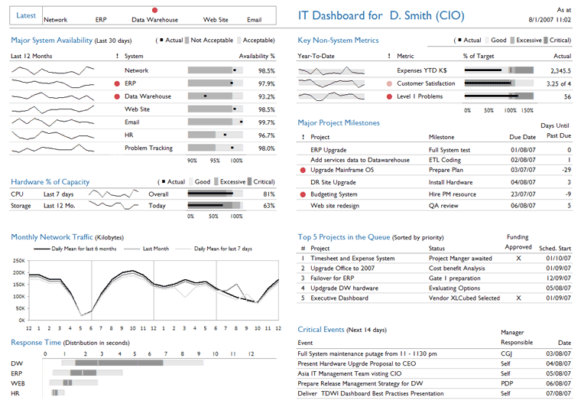
Dashboard – High Effectiveness
Source: Information Dashboard Design by Stephen Few
Notes:
Compare to the CIO dashboard from Information Dashboard Design by Stephen Few.

Slide 20
CIO Dashboard
One gauge takes the same space that can accommodate twenty data points in this dashboard design.
Source: Information Dashboard Design by Stephen Few
Notes:
The gauges, which are often very large on dashboards, take up a large portion of the dashboard for a single KPI. We can build dashboards that are much more effective without the use of these glitzy tools.

Slide 21
Dashboard – High Effectiveness
Source: Information Dashboard Design by Stephen Few
Notes:
Slides duplicated to show with/without gauge again.

Slide 22
CIO Dashboard
One gauge takes the same space that can accommodate twenty data points in this dashboard design.
Source: Information Dashboard Design by Stephen Few
Notes:
Slides duplicated to show with/without gauge again.

Slide 23
Dashboard “Dos”
Content position and size should match its
importance and frequency of use
Use color and formatting to draw attention
where needed, rather than to decorate
Visually associate data and content that is related
Use the needs of the user to drive the layout, rather than forcing layout with an inflexible grid (note: this is a consideration when choosing tools)
Few, Stephen (2013), Information Dashboard Design, p. 28
When deciding placement, consider how the eye will scan the page…

Slide 24
Layout Basics
Notes:
Not going to look at all graph types, just the main ones.

Slide 25
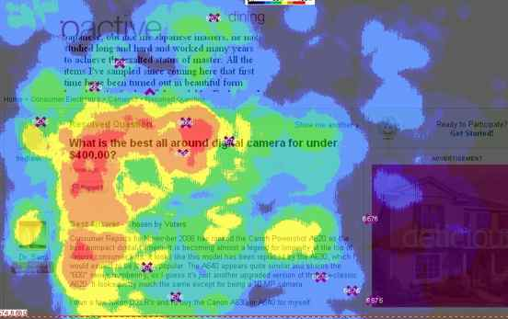
Eye Scanning Patterns (Web)
Red indicates more visual attention on that portion of the page
Source: http://styleguide.yahoo.com/writing/write-web/eye-tracking-where-do-readers-look-first

Slide 26
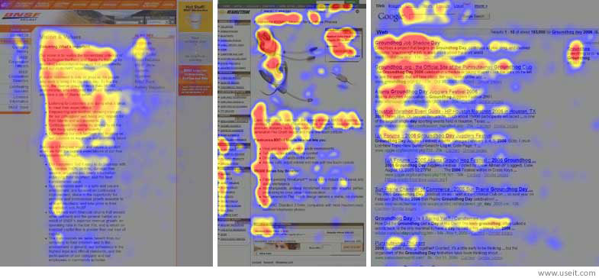
Eye Scanning Patterns (Web)
This “F” pattern is widely cited on the web but is partially a product of text-heavy pages.
Source: http://www.useit.com/alertbox/reading_pattern.html

Slide 27
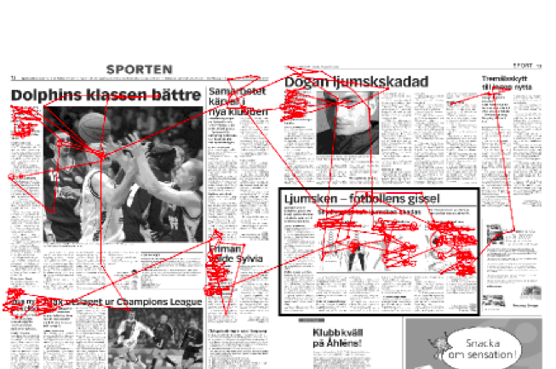
Patterns are affected by content…
…as well as the form of media being read.
Source: http://www.humlab.lu.se/resources/publications/studentpapers/Holmberg_04.pdf

Slide 28
Emphasis Guidelines for Dashboards
Most emphasis
Neutral
Neutral
Least emphasis
Dominance of the neutral quadrants may change based on content.
Source: http://www.useit.com/alertbox/reading_pattern.html

Slide 29
Sales Team Dashboard
Source: Information Dashboard Design by Stephen Few
Notes:
This is a sales team dashboard from Stephen Few’s book, Information Dashboard Design. Let’s see how it does with the emphasis guidelines.

Slide 30
Sales Team Dashboard
Most emphasis
Neutral
Neutral
Least emphasis
Source: Information Dashboard Design by Stephen Few
Notes:
It’s not a perfect quadrant, but it works pretty well. The most important information about overall rep performance is in the top left quadrant.

Slide 31
CIO Dashboard
Source: Information Dashboard Design by Stephen Few
Notes:
Here is a CIO dashboard, also from Stephen Few’s book. Let’s see how this one does with the quadrant grid.

Slide 32
CIO Dashboard
Most emphasis
Neutral
Neutral
Least emphasis
Source: Information Dashboard Design by Stephen Few
Notes:
This one lines up perfectly. In the top left corner we see the most critical information, “System Availability”, which as a CIO would certainly be the most important thing to monitor. Are the systems up and running? The least important information are the project status updates. The neutral areas are filled with non-system metrics and overall monthly network traffic.

Slide 33
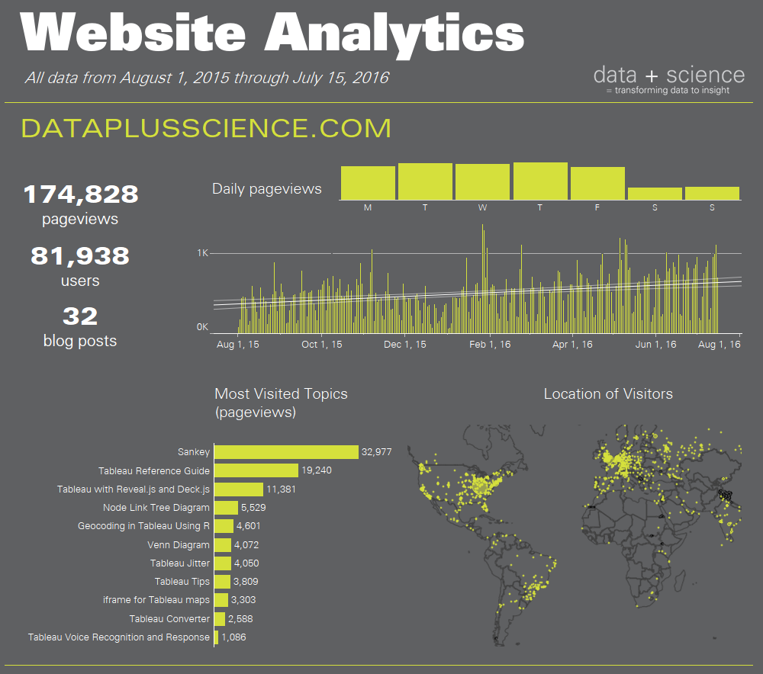
Source: The Big Book of Dashboards (BigBookofDashboards.com)
Notes:
Here is the Web Analytics Dashboard from The Big Book of Dashboards.

Slide 34
Most emphasis
Neutral
Neutral
Least emphasis
Source: The Big Book of Dashboards (BigBookofDashboards.com)
Notes:
This dashboard is not perfectly aligned to a four quadrants, but the big numbers are on the top left and the map is on the bottom right.

Slide 35
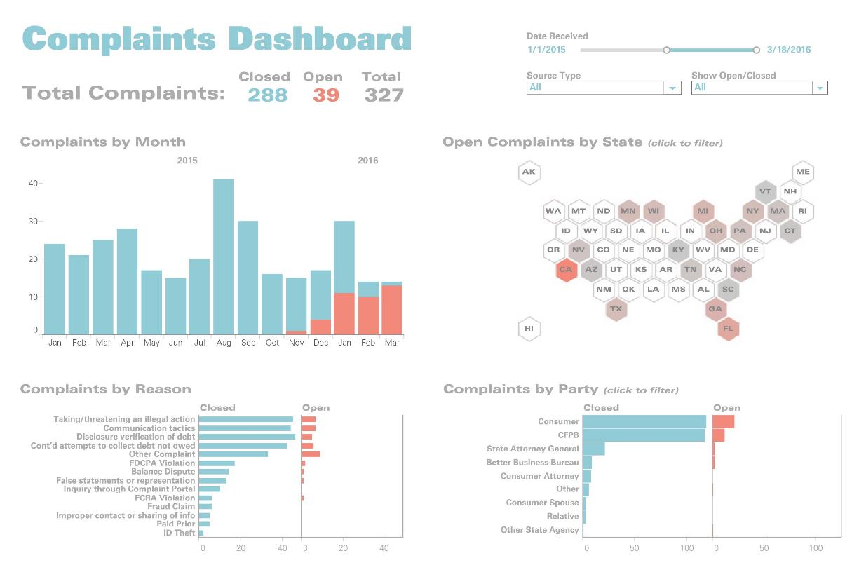
Notes:
This is the Complaints Dashboard from The Big Book of Dashboards.

Slide 36
Most emphasis
Neutral
Neutral
Least emphasis
Notes:
You’ll notice that it’s designed to a four quadrant grid, but the top section is a little taller than the bottom section.

Slide 37
Tableau Eye Tracking Research
Notes:
In 2016, Tableau Software began working on a research around eye tracking. At the 2016 Tableau Conference in Austin, TX, they set up this eye tracking system in one of their demo labs. Attendees could come in to the lab and sit at a station to look at dashboards. As their eyes looked over a number of different dashboards, the results could be seen on another screen. Tableau has not published any findings yet, but this is a fascinating area of research in data visualization. It will be exciting to see what can be learned from this as the research progresses.

Slide 38
Source: The Big Book of Dashboards (BigBookofDashboards.com)
Notes:
The Web Analytics Dashboard from The Big Book of Dashboards is one of the dashboards that is being studied by Tableau as part of their eye tracking research.

Slide 39

Notes:
What’s interesting in this one is that there is balance in this design. The bottom left-hand corner is catching the eye, but the end result of this dashboard is the evenness as the eyes scan the dashboard.

Slide 40
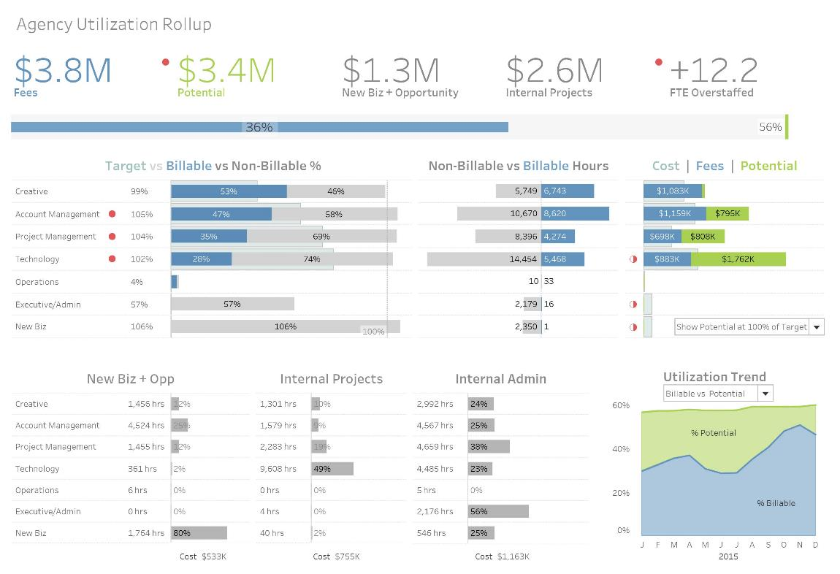
Source: The Big Book of Dashboards (BigBookofDashboards.com)
Notes:
Here is another example from The Big Book of Dashboards. This Agency Utilization dashboards has large numbers across the top of the dashboard. It’s designed to a grid, but is not in the traditional four quadrant design. Let’s see what the readers' eye do on this one.

Slide 41
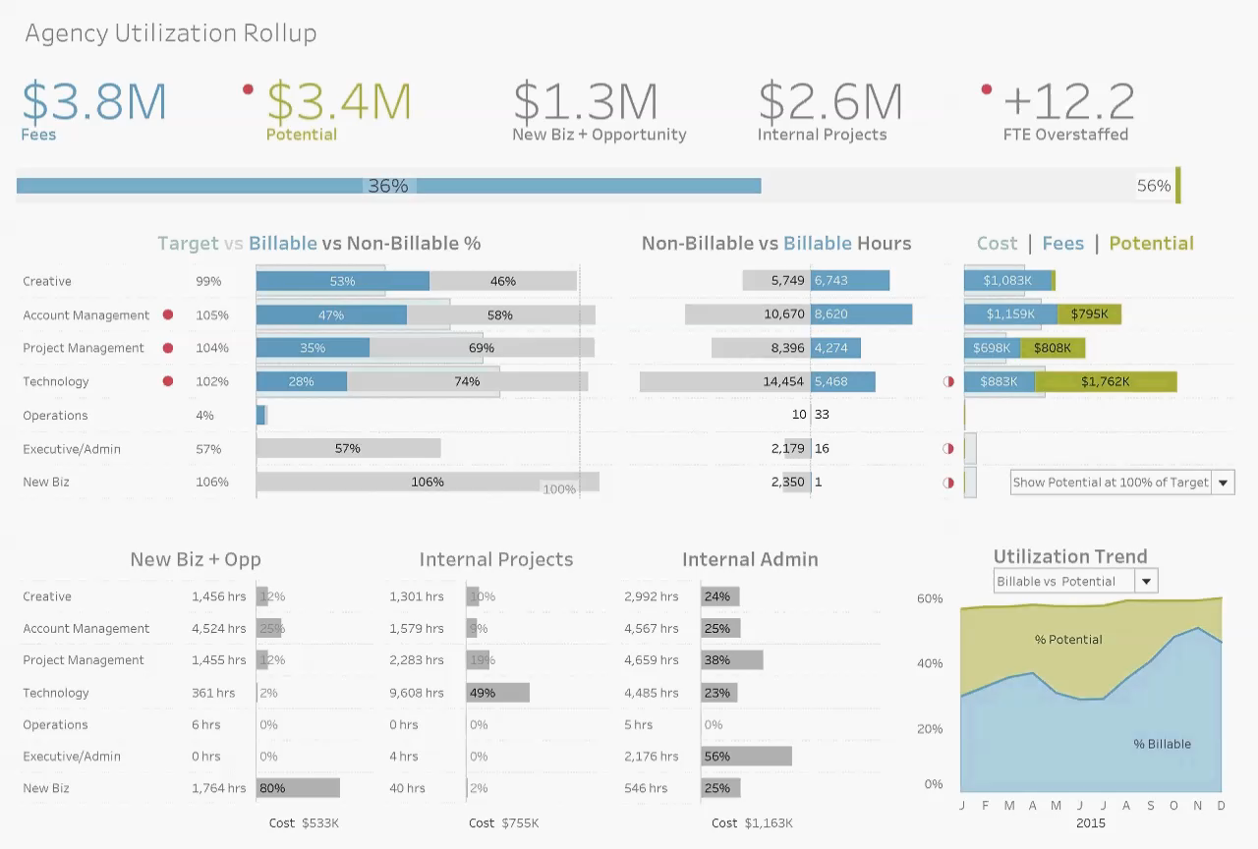
Notes:
Notice that the big numbers catch the attention across the top, as does the color of the stacked area chart in the bottom right-hand corner.

Slide 42
What Makes Visualization Actionable?

Slide 43

“At their best, graphics are instruments for reasoning about quantitative information. Often the most effective way to describe, explore, and summarize a set of numbers is to look at pictures of those numbers.”
- Edward R. Tufte, Ph.D. Professor Emeritus, Yale University, and author of
The Visual Display of Quantitative Information

Slide 44
Questions and Analytics Maturity
Improved
Decision
Making
Optimization
What is the best that can happen?
Predictive
Modeling
What will happen next?
Forecasting
What if these trends continue?
Statistical
Analysis
Why is this happening?
Alerts
What actions are needed?
Query
Drilldowns
Improved Business Value
Where exactly is the problem?
How many, how often?
Ad Hoc
Reports
Standard
Reports
What happened?
Source: LÛCRUM Incorporated.
Notes:
This is similar to the business intelligence model of moving data to information and information to knowledge. This continuum created by Lucrum shows the progression of moving from standard reports to adhoc reports and

Slide 45
Key Performance Indicators (KPIs)
A KPI is a type of performance measurement, used to evaluate success or achievement against a specific goal
Can be operational or strategic
Help to identify areas that need attention
More “where to look” vs. “this happened”
Knowledge of “what matters” to an organization makes KPIs relevant
Often included in dashboard displays
You must know what you’re measuring and what performance is desired before you create a KPI.
Notes:
KPIs and dashboards focus on directed discovery
Analytical tools provide the ability for exploratory discovery
- drill in, filtering, grouping, adding variables, cross-tabs, etc.

Slide 46
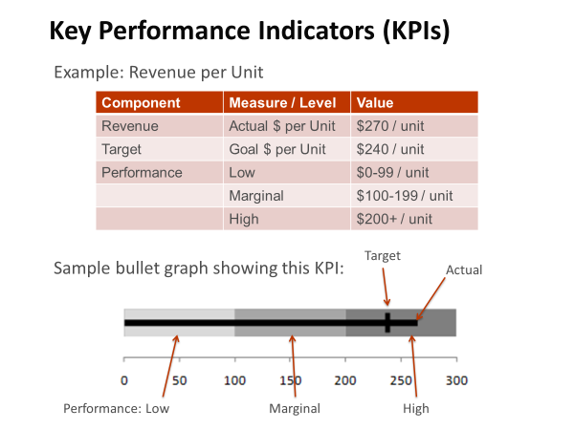
Notes:
Here are some examples of a key performance indicator. We can also show it graphically. A bullet graph, invented by Stephen Few, is a great option for this. Notice that all of the data from the data table has been encoded into the bullet graph.

Slide 47
The Duell Rules For Actionable Visualizations
Created by Eric Duell
Used by Permission
Notes:
Eric Duell is the Vice President of Analytics and Intelligence at the E.W. Scripps Company. He created the “Duell Rules” for Actionable Visualizations. Let’s walk through these.

Slide 48
Duell Rules for Actionable Visualizations
The question to answer must be identifiable*
Articulate the question you wish to answer and write it out: “I want to know who my best customers are.” “ I need to be able to identify customers at risk.” “How is our sales team performing against its goals?”
*Note – This is different from Exploratory Data Analysis
Used by permission of Eric Duell

Slide 49
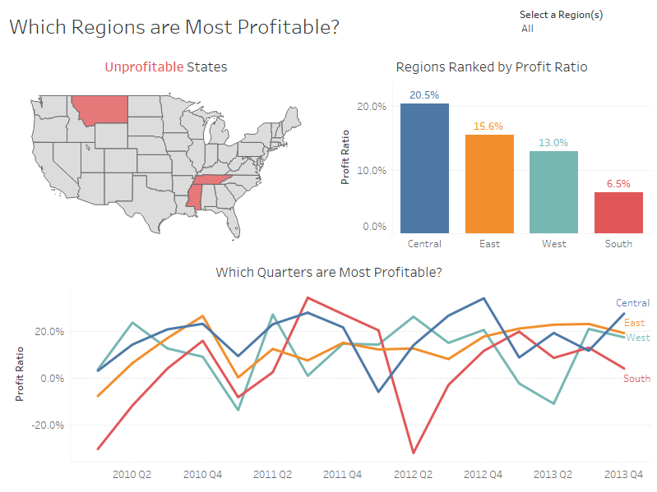
Notes:
In this example by Andy Kriebel, he starts out the visualization asking a question. “Which Regions are Most Proftiable?”
Source:
https://public.tableau.com/profile/andy.kriebel#!/vizhome/ReplaceReferences/Example

Slide 50
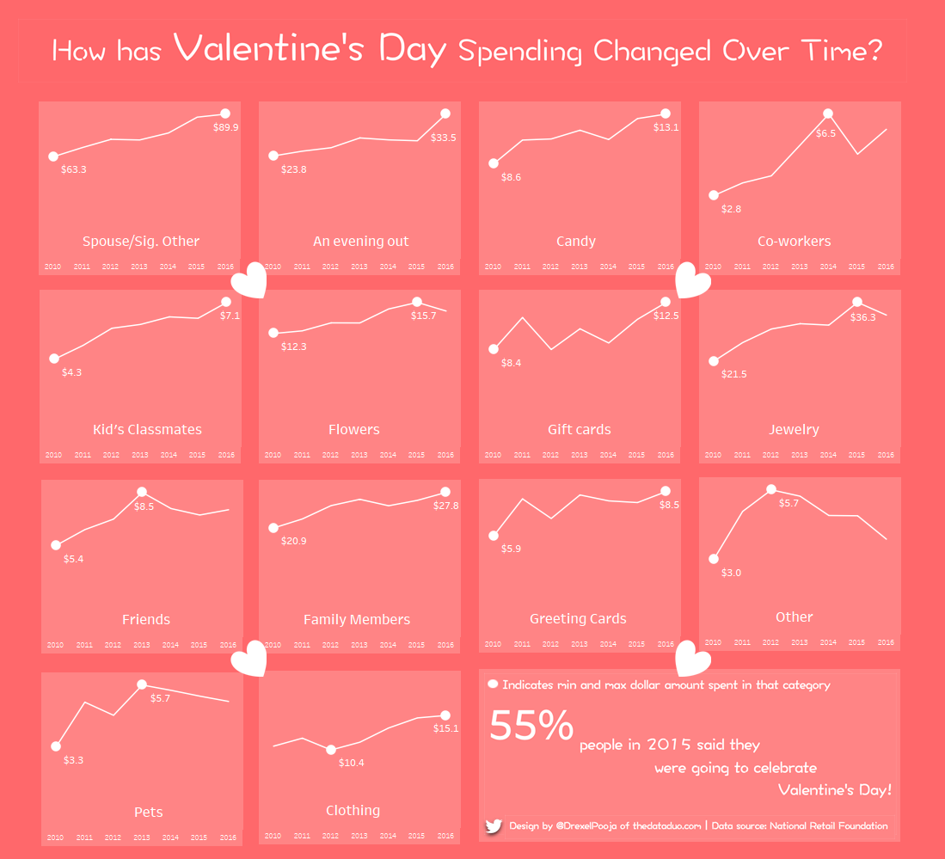
Notes:
The question on Pooja Ghandi’s visualization is clear. “How has Valentine’s Day spending changed over time?”

Slide 51
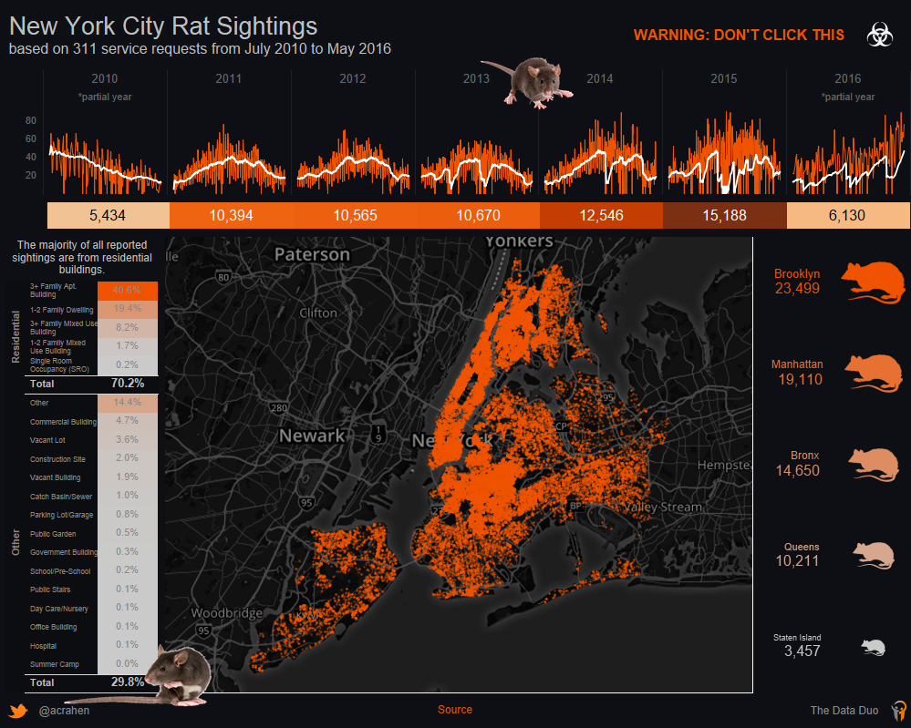
Notes:
The question does not have to be overtly asked on the visualization. Even without a question in the title, this viz by Adam Crahen answers all sorts of questions about rat sighting in New York City.

Slide 52
Duell Rules for Actionable Visualizations
The data needed must be available In some cases, you may need to create it, based on conditions in the data you already have, or by bringing in additional data from another source.
Used by permission of Eric Duell

Slide 53
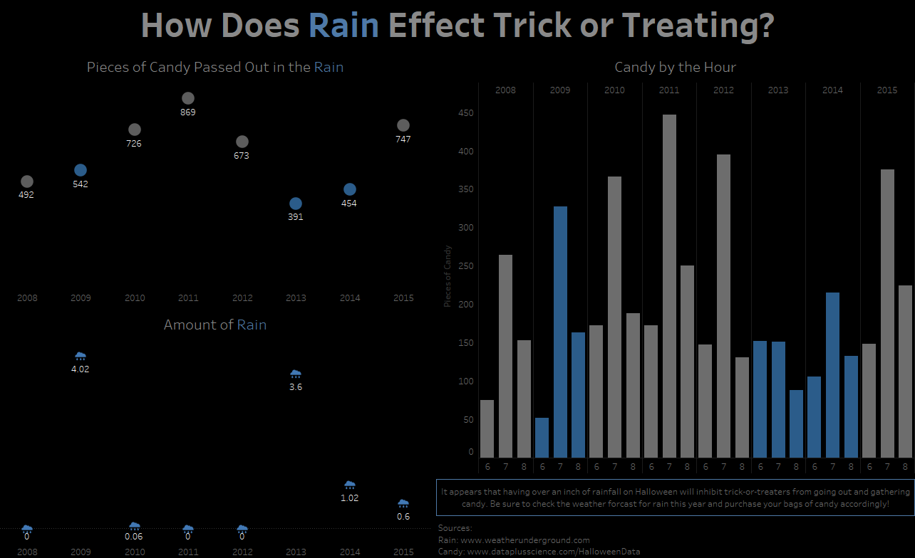
Notes:
The Halloween data is a good example where the data is gathered every year at Halloween, but additional data can be appended to create a rich analysis. In this case, weather data.

Slide 54
Duell Rules for Actionable Visualizations
The visualization should be tailored to the person who will use the information
Your audience may be “the general public” but in other cases, it’s the VP of Finance. You may discover you need more than one to cover all levels of the organization!
Used by permission of Eric Duell

Slide 55
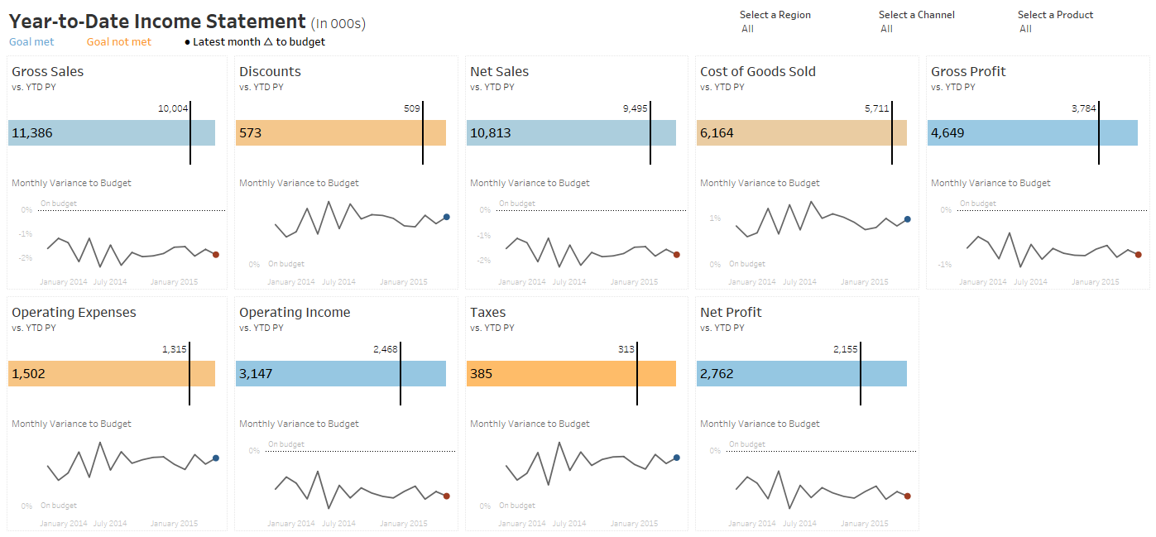
Notes:
This visualization by Andy Kriebel visualizes key elements from the Income Statement. While it won’t replace a traditional income statement for accountants and finance executives, it provides a view of the data that isn’t available in a traditional income statement. It is designed for a specific audience in mind, possibly the VP of Finance and Accounting.

Slide 56
Duell Rules for Actionable Visualizations
The story uncovered in the visualization should be evident
The viewer should not need an advanced degree in statistics to interpret the visualization, or have to make leaps of logic to understand what the data really means.
Used by permission of Eric Duell

Slide 57
Notes:
Andy answers the question in his visualization in a number of different ways. He shows the unprofitable states, the regions ranks by profit ratio and then the regions over time. He set up a question and then he answers it in an obvious way.
Source:
https://public.tableau.com/profile/andy.kriebel#!/vizhome/ReplaceReferences/Example

Slide 58
Duell Rules for Actionable Visualizations
The action required should be clear
Framed by the original question, this answers “what do I need to do?” based on the findings.
Used by permission of Eric Duell

Slide 59
Notes:
Having a clear action applies to both using the visualization and interpreting the output of the visualization. The visualization should give clear direction, especially if there are interactive features. Make sure the user knows what to click to get to the information. This could be a simple annotation of “click to filter”, “select category” or “hover for additional information”.

Slide 60
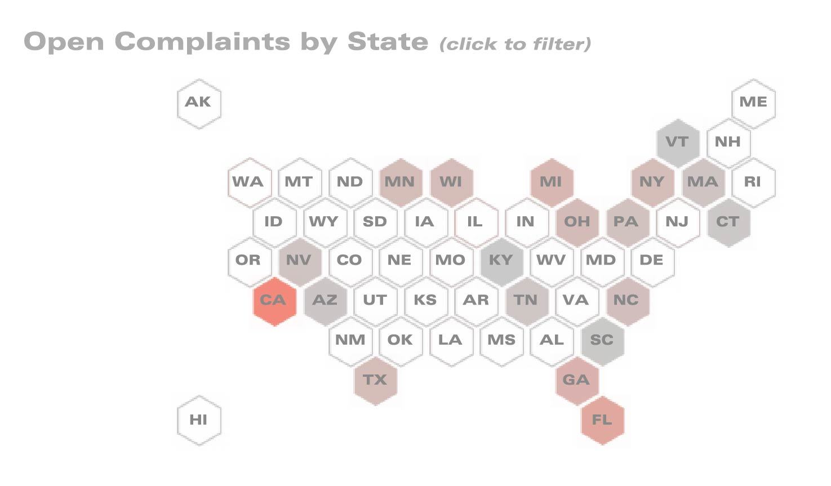
“Click State to Filter”
Source: The Big Book of Dashboards (BigBookofDashboards.com)
Notes:
Zoomed in to the chart to see the direction.

Slide 61
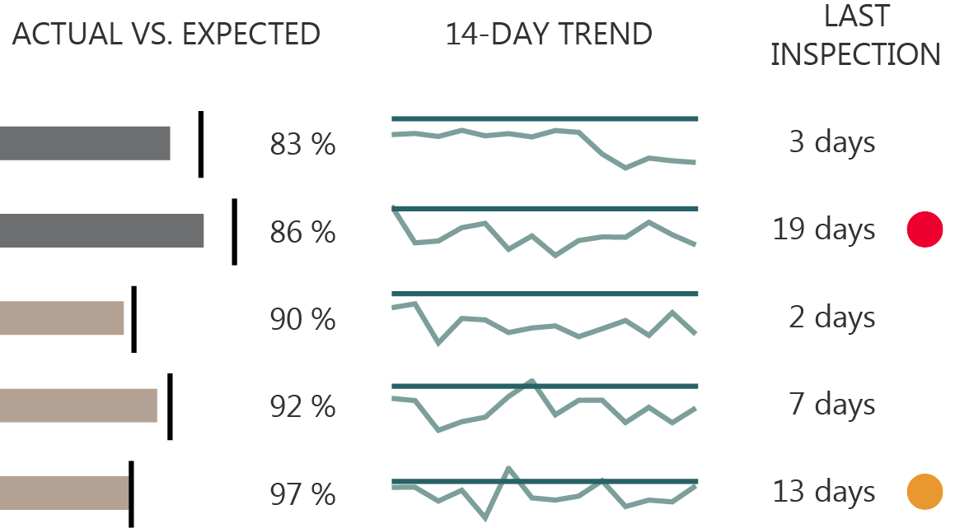
“19 days is too long. I should do something.”
Source: The Big Book of Dashboards (BigBookofDashboards.com)
Notes:
The action required as a result of the output from the visualization should also be clear. We can see here it’s been 19 days since the last inspection for one of these power stations. These little indicators will help draw attention to these problems so that the reader knows they need to do something.

